Slide 1

BENGALURU | HYDERABAD | VIJAYAWADA
Notes:
The Internet Minute

Slide 2
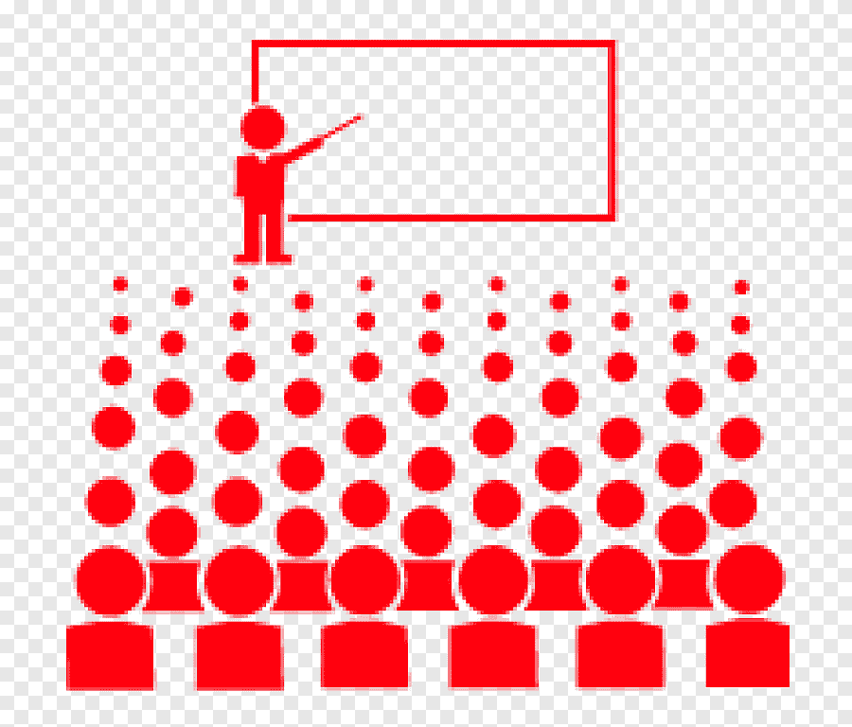



Our Solution
Equip Students with Core Fundamentals and Latest Technologies
Assess students & provide needed Help
Make them Job Ready

Slide 3


Slide 4
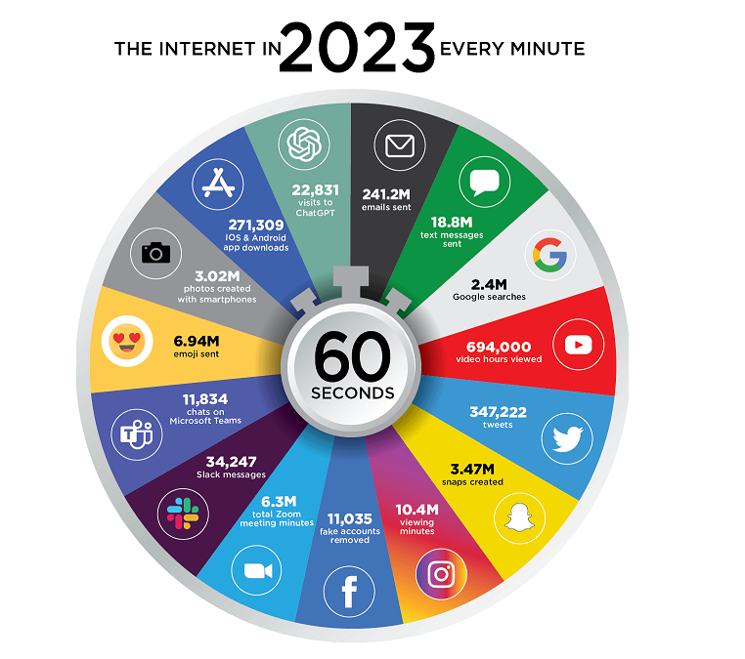

Slide 5
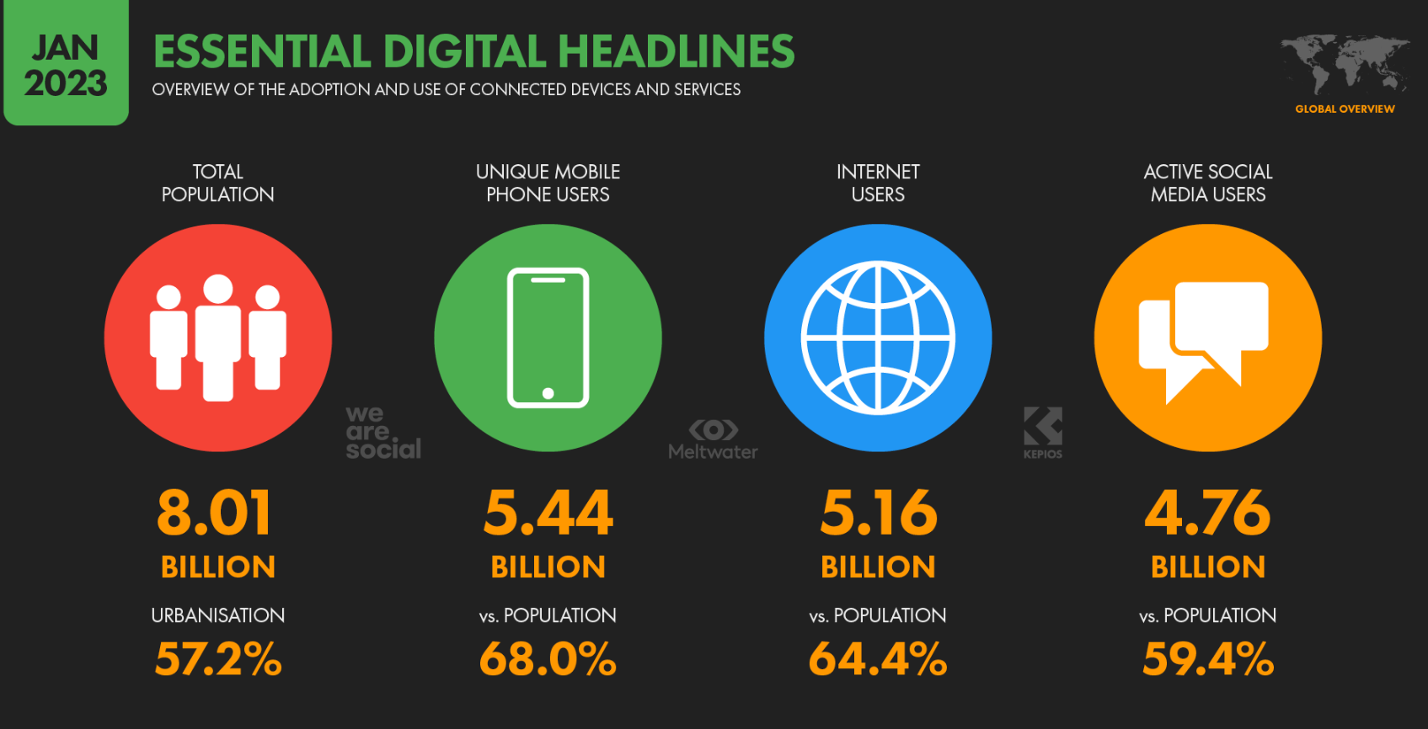

Slide 6
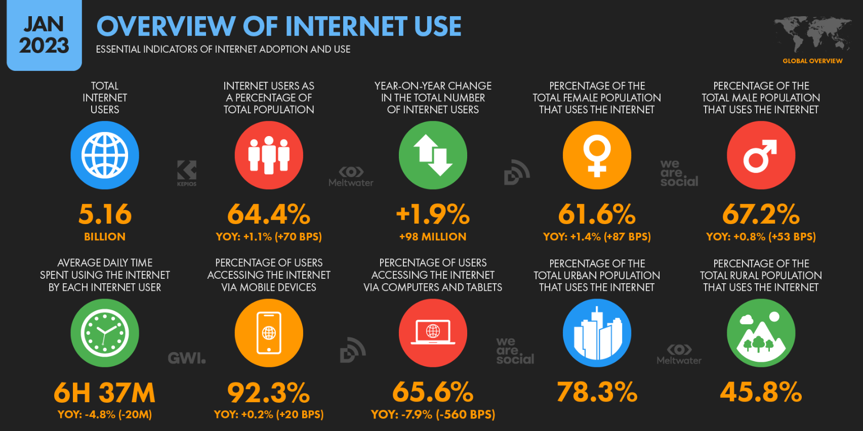

Slide 7
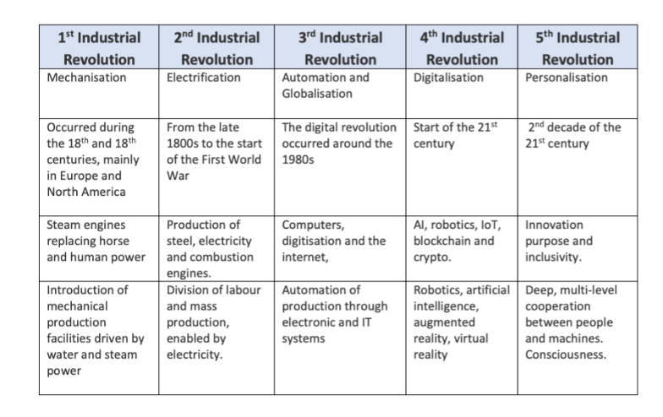
Notes:
We live in a world that is drowning in data

Slide 8


Slide 9
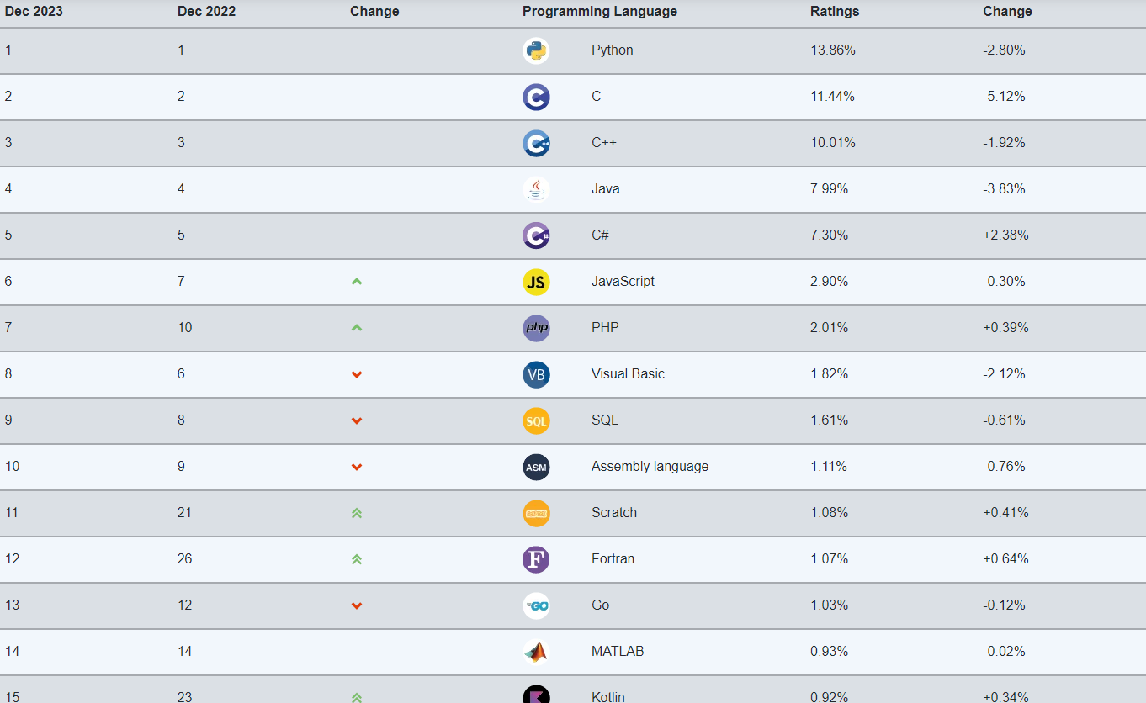

Slide 10
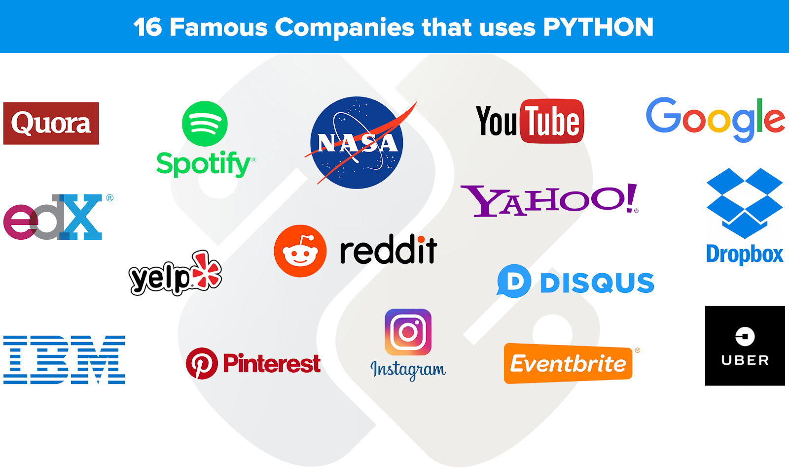

Slide 11
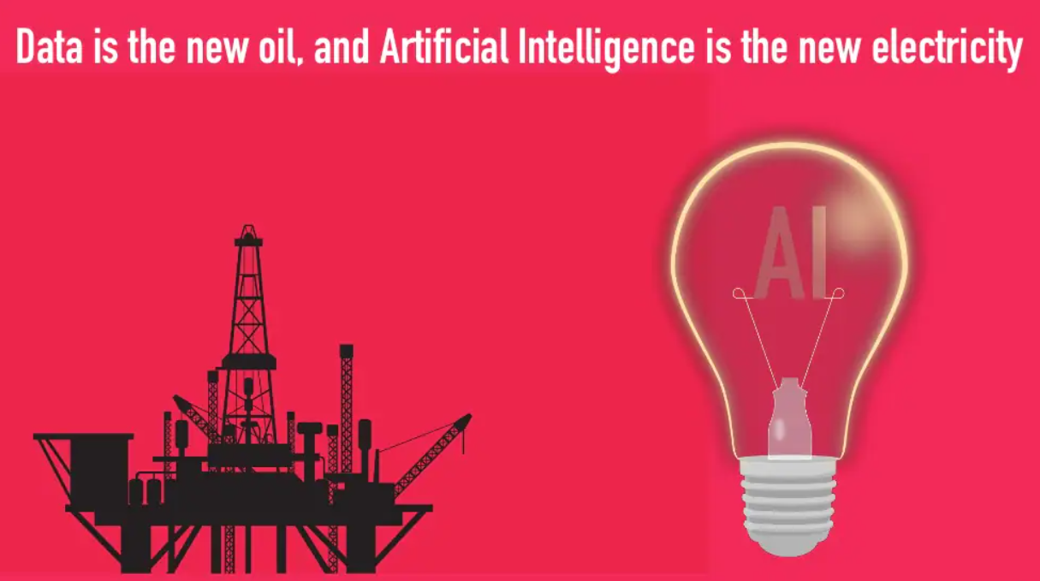

Slide 12
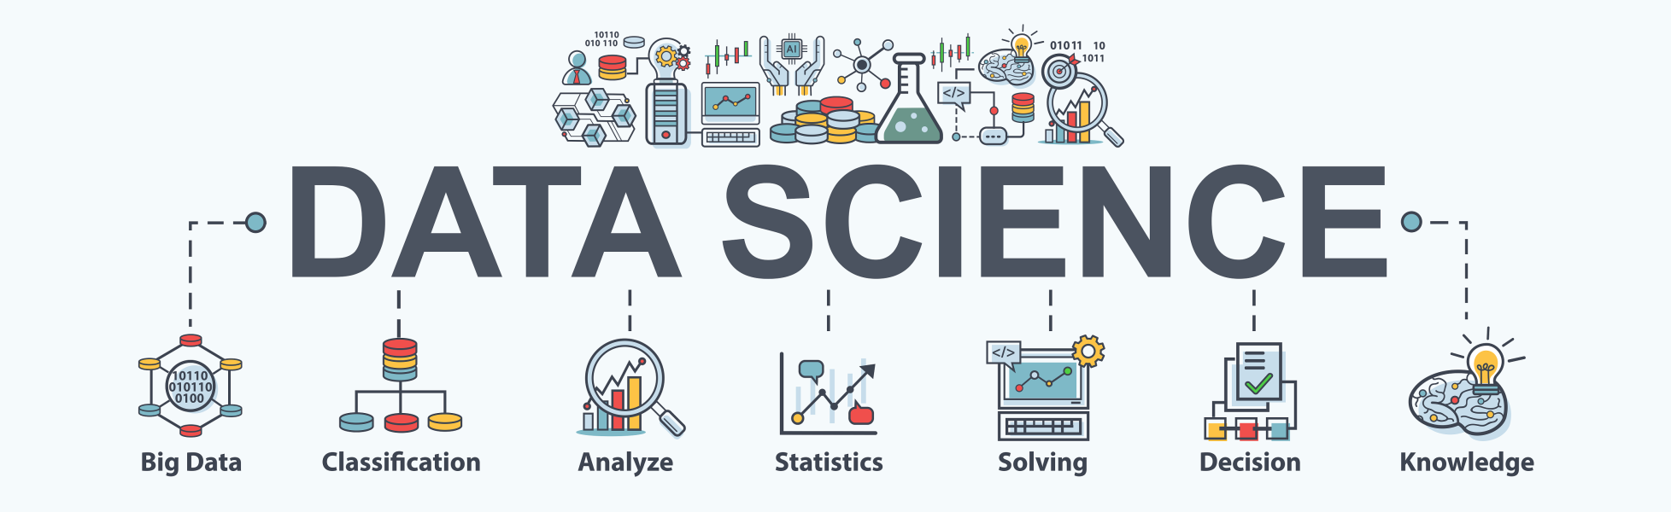

Slide 13
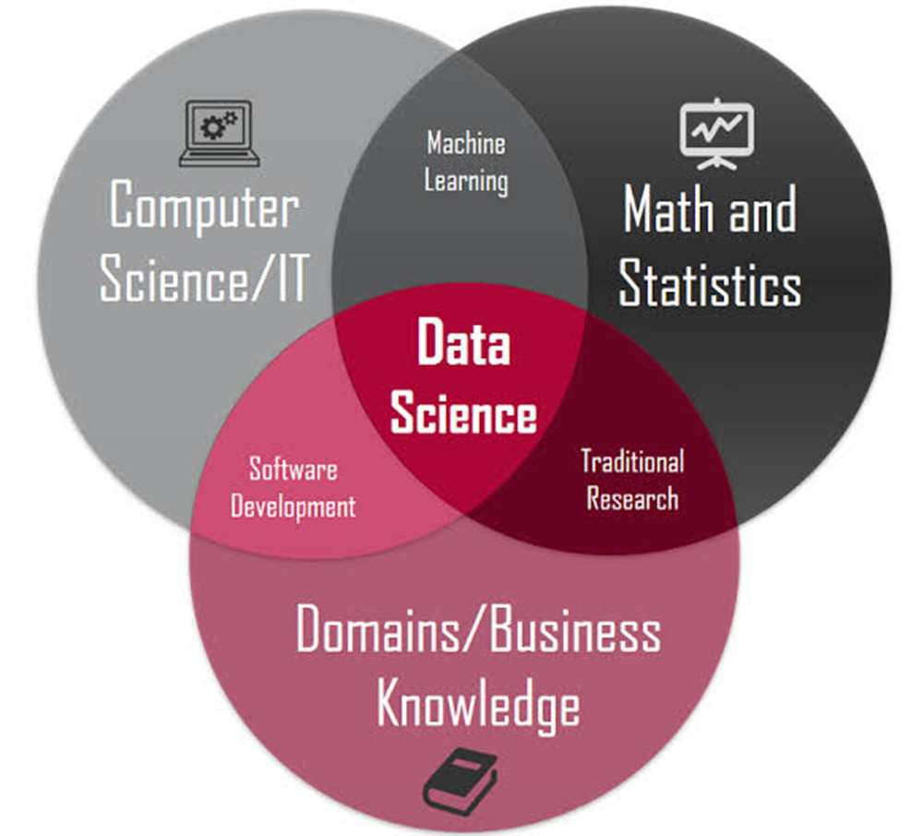

“Data Science is a multidisciplinary field to extract knowledge and insights from data.”

Slide 14

“AI is akin to building a rocket ship. You need a huge engine and a lot of fuel. If you have a large engine and a tiny amount of fuel, you won’t make it to orbit. If you have a tiny engine and a ton of fuel, you can’t even lift off. To build a rocket you need a huge engine and a lot of fuel. The rocket engine is the learning algorithms, but the fuel is the huge amounts of data we can feed to these algorithms”

Slide 15

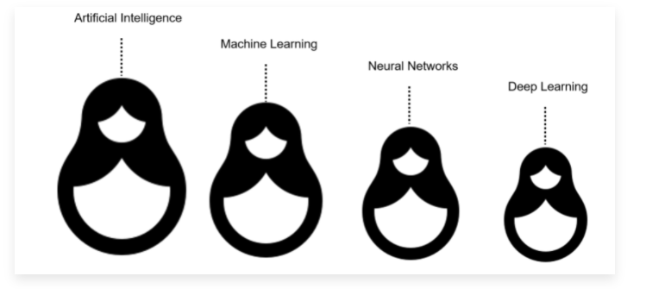
Notes:
Machine learning is a subfield of artificial intelligence. Deep learning is a subfield of machine learning, and neural networks make up the backbone of deep learning algorithms. In fact, it is the number of node layers, or depth, of neural networks that distinguishes a single neural network from a deep learning algorithm, which must have more than three.

Slide 16
Data Science vs Artificial Intelligence
Data Science is a concept used to tackle big data and includes data cleansing, preparation, and analysis. A data scientist gathers data from multiple sources and applies machine learning, predictive analytics, and sentiment analysis to extract critical information from the collected data sets.
Artificial Intelligence aims at enabling machines to execute reasoning by replicating human intelligence. Since the main objective of AI processes is to teach machines from experience, feeding the right information and self-correction is crucial.
AI experts rely on deep learning and natural language processing to help machines identify patterns and inferences.

Slide 17
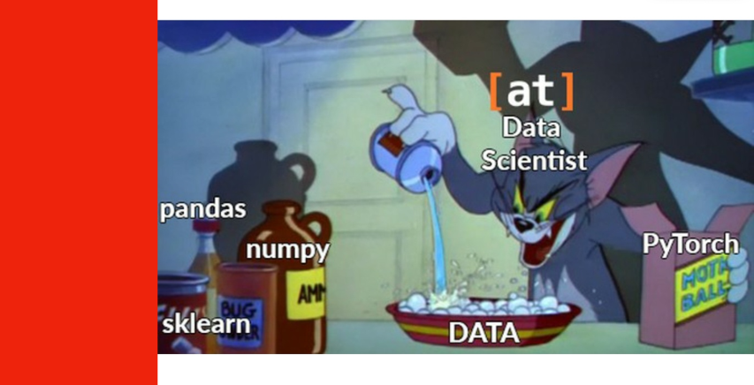

Slide 18
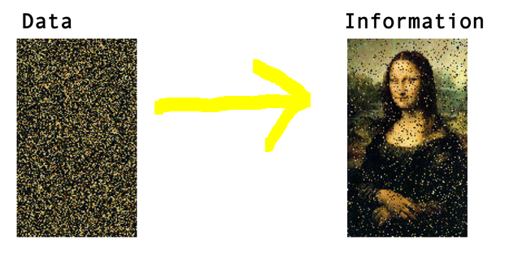
Data vs Information
Data can be any character, number, images, word text which is raw and unorganized.
It can be considered as raw facts, which is input to the computer.
Whereas Information is created from data.
It is an output from a Computer
Data alone can never be significant. But information is always important by itself

Slide 19
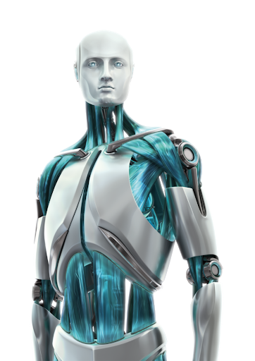


THE IDEA OF MACHINE LEARNING
LEARN FROM EXPERIENCE
LEARN FROM DATA
TAKES INSTRUCTIONS

Slide 20
WHAT IS MACHINE LEARNING?
“Machine Learning is the field of study that gives computers the ability to learn without explicitly programmed.”

Slide 21
TRADITIONAL SYSTEMS VS MACHINE LEARNING
Traditional Systems
DATA
PROGRAM
RULE BASED PROGRAMS
OUTPUTS
DATA
MACHINE LEARNING ALGORITHMS
OUTPUTS
Machine Learning

Slide 22
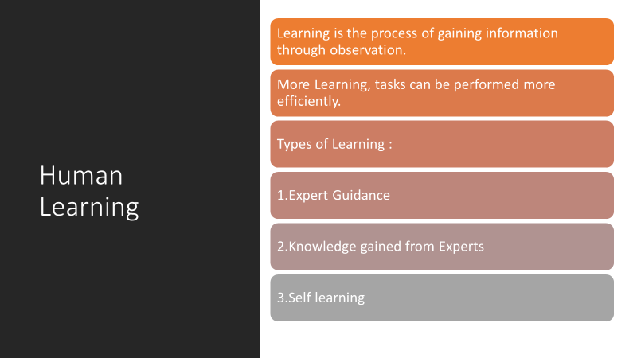

Slide 23
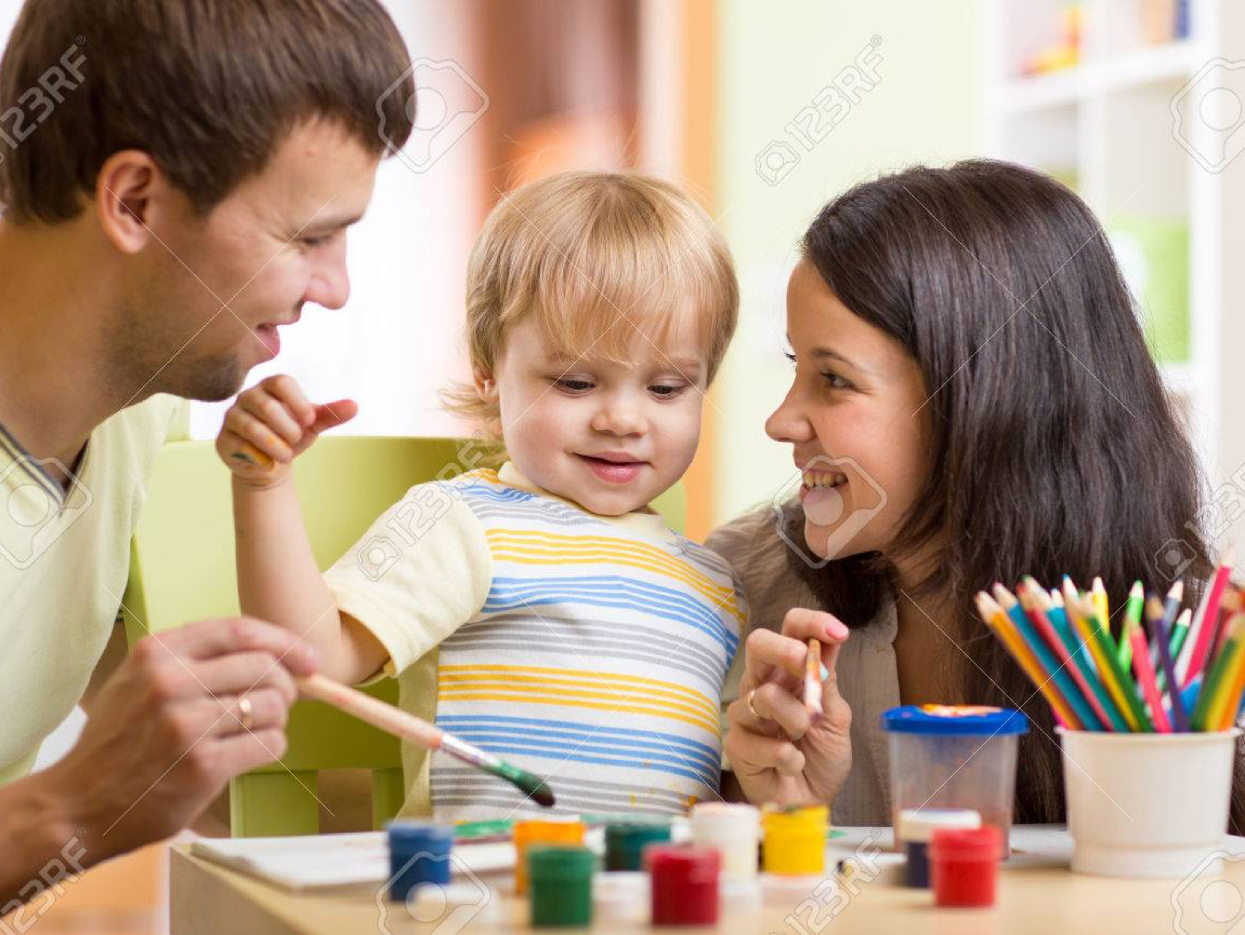

Slide 24
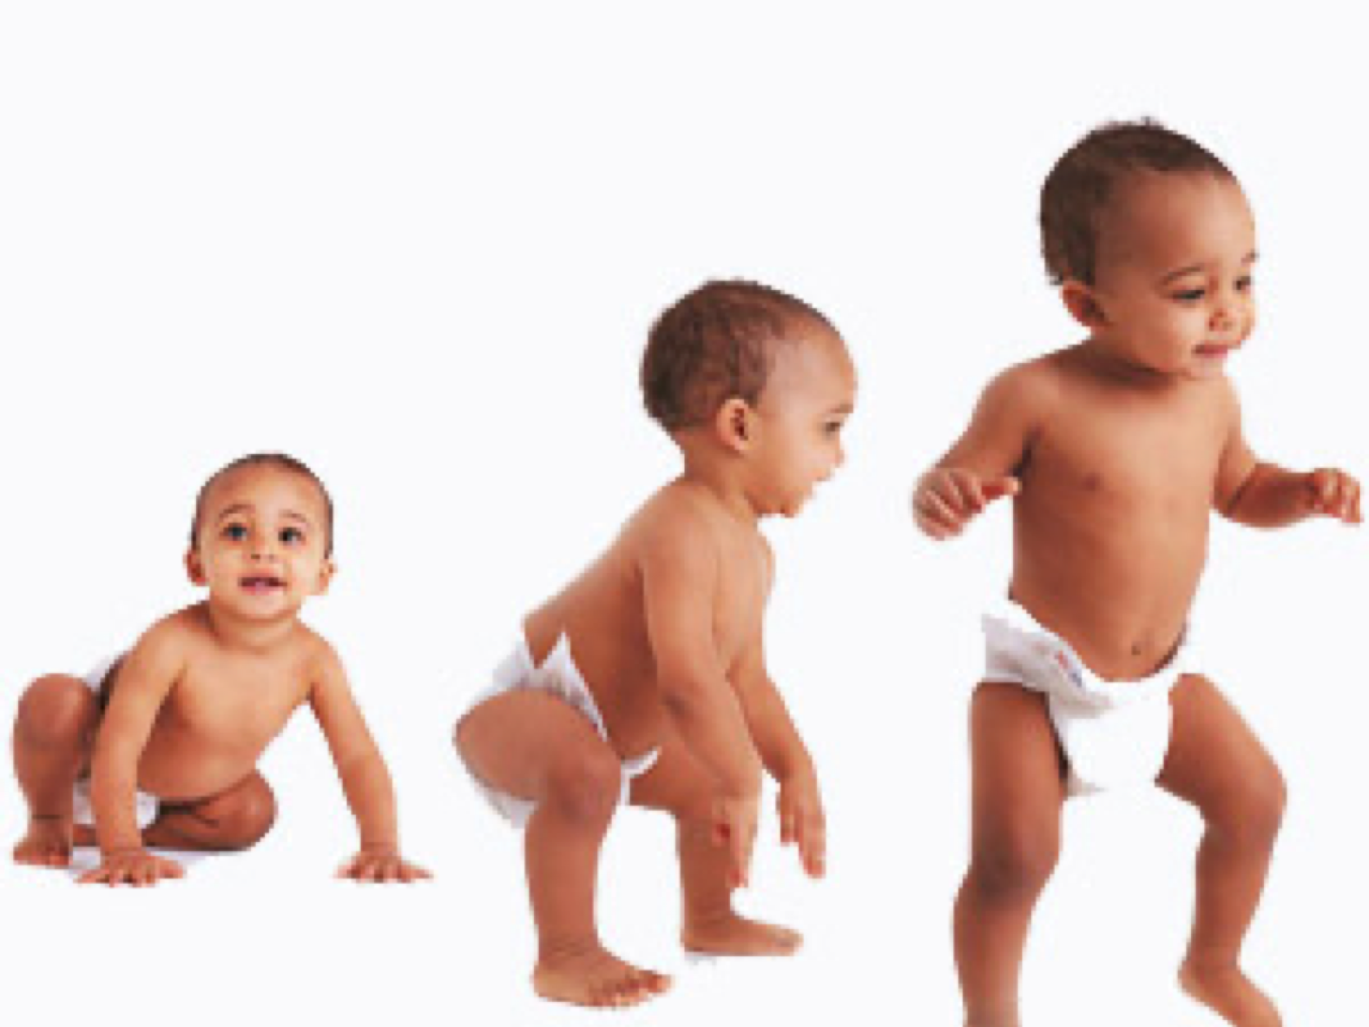

Slide 25


Slide 26
Has been in the picture from the past 50 years
Initially coined by Arthur Samuel in the year 1959 as Field of Study that gives computers the ability to learn without being explicitly programmed.
It was not that significant as of today 25 years ago.
Best definition by Tom Mitchell -A Computer Program is said to learn from experience "E" with respect to some class of tasks "T" and performance measure "P", If its performance at tasks in "T“ as measured by "P", improves with experience "E".
Machine Learning

Slide 27
22 years ago IBMs Deep Blue beat World Chess Champion Gary Kasparov, which marked the importance and gave people a serious attention.
Then in the 21st century everything has seen exponential growth in the development and applications.
2006 marked the word Deep Learning by publications made by Geoffrey Hinton from the concept of Deep Belief Nets.
2011 IBM Watson beat Human champions in Jeopardy.
Google started Brain Team and X Lab.
2014 FaceBook Face Tagging (DeepFace)
2016 Google’s Alpha Go beat Professional Players in Go game.
2017 - 2019 Self Driving Cars and Tensorflow influence.
Attention

Slide 28
Did you know?
Machine learning saves life - ML can spot 52% of breast cancer cells, a year before patients are diagnosed
US Postal Service uses Machine Learning for handwriting recognition
Facebook’s News Feed uses machine learning to personalize each member feed.
Uttar Pradesh has deployed AI-enabled video analytics platform “Jarvis” in 70 prisons to monitor inmates.
Robocop joins Kerala Police in 2019
Online Education with Autosuggestions
Tesla Invented their own Neural Network “Systems and methods for adapting a neural network on a hardware platform”

Slide 29
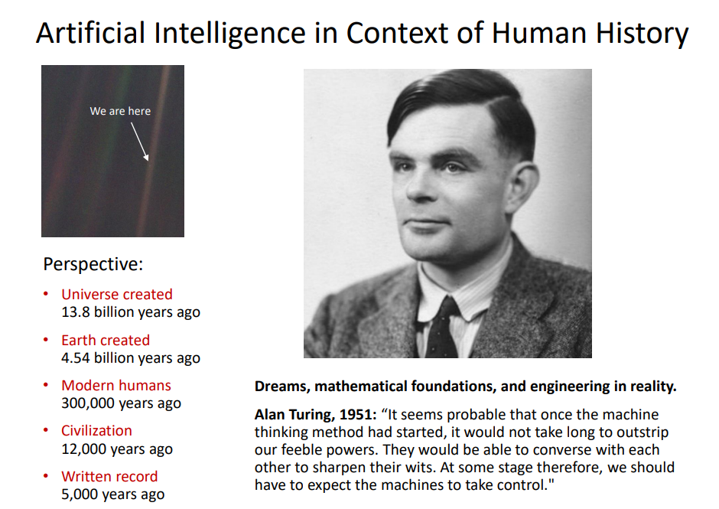

Slide 30
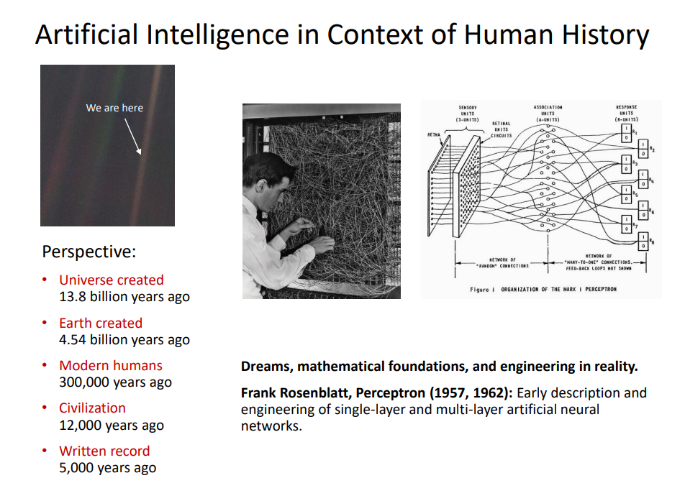

Slide 31
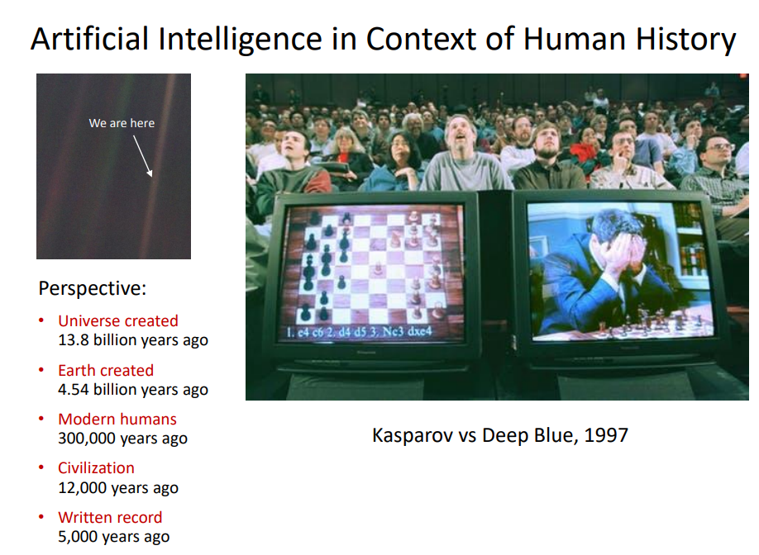
Notes:
200 million positions per second.We must face our fears if we want to get most out of our technology and we must conquer those fears if we want to get the best out of our humanity.

Slide 32
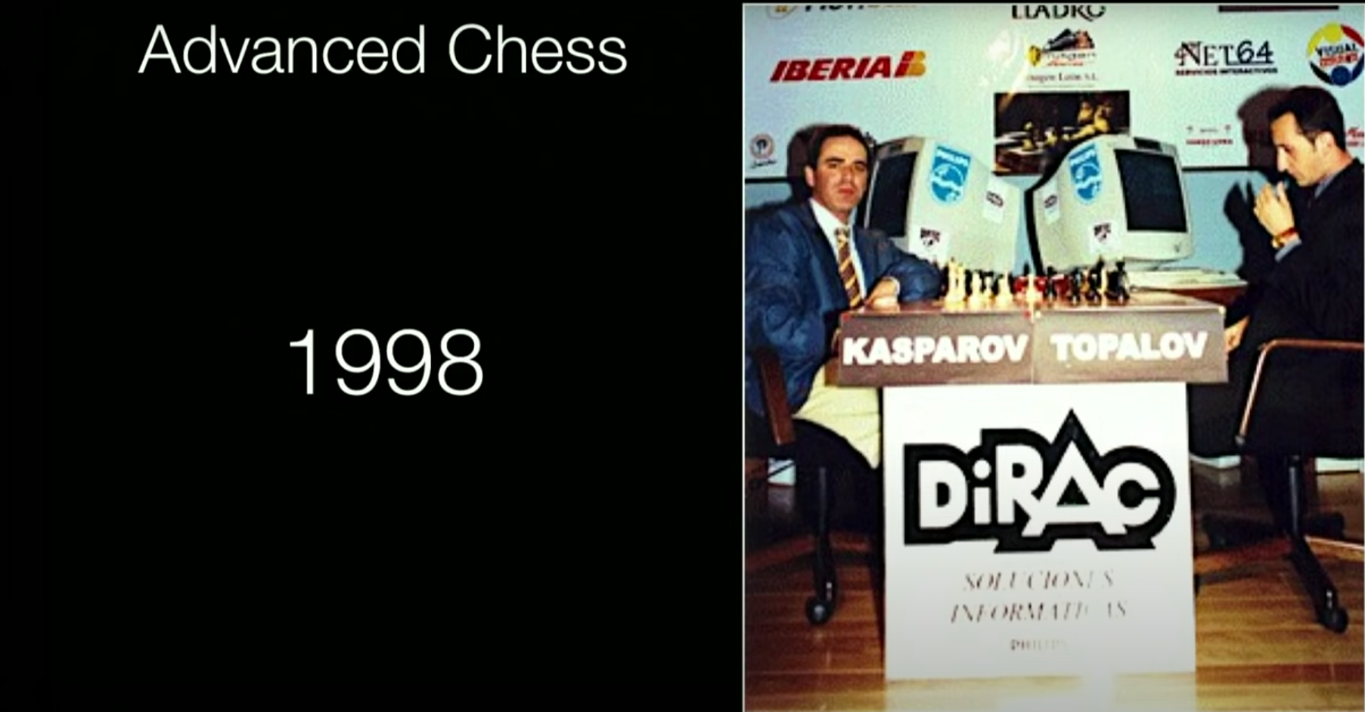
Notes:
Human intuiton+ Machine calculation, Human Strategy+Machine Tactics, Human experience + Machine Memory, Human plus machine against another Elite player but it failed to combine human and machine skills effectively
2005 FreeStyle chess tournament produced a revelation →team of grandmasters and top machines participated but winners were pair of amateurs (not professional players) operating 3 ordinary pcs at a time which gave rise to awareness of a weak human player + a machine + a better process is superior to a powerful machine alone more remarkably is superior to a strong human player + machine + inferior process thus need a better interface to coach machines towards more useful intelligence →RISE OF GPU

Slide 33
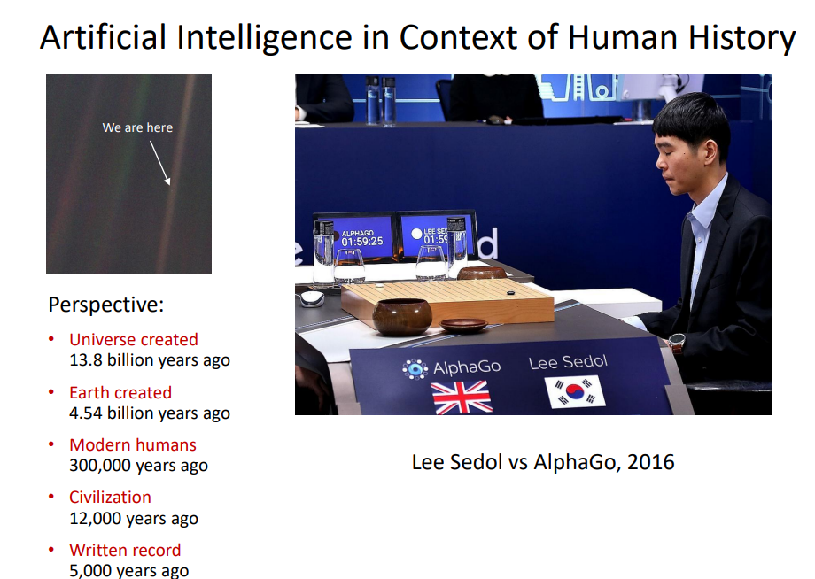
Notes:
Human + Machine is not future it’s the present →Machine crunches data, calculates the probabilities and gets -80-90% of the way making it easier for analysis and decision making of the human party
We don’t get to choose when and where technology progress stops we cannot slow down infact we have to speed up our technology excels at removing uncertainties from our life

Slide 34
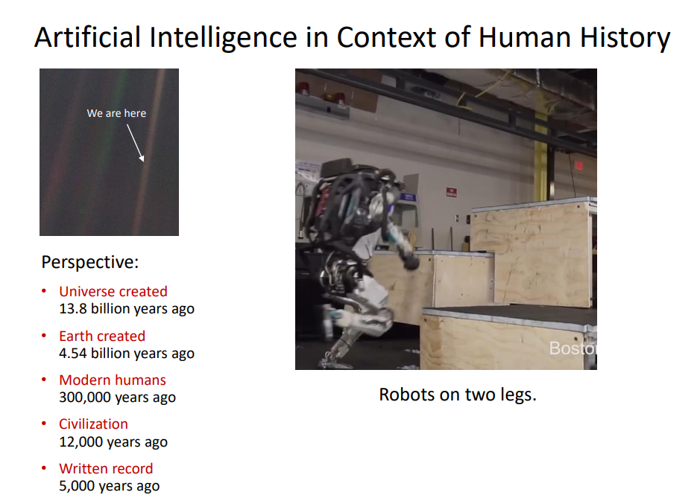
Notes:
Machines have Calculations, we have understanding
Machines have instructions we have purpose
Machines have objectivity we have passion
We should not worry about what our machines can do today ,instead we should worry about what they still cannot do today. Because we will need the help of new, intelligent machines to turn of grandest dreams into reality
One thing only human can do so let us dream big

Slide 35

Dr. Dabbala Rajagopal Reddy First Asian to be awarded the A.M. Turing Award - the highest honour in Computer Science

Slide 36
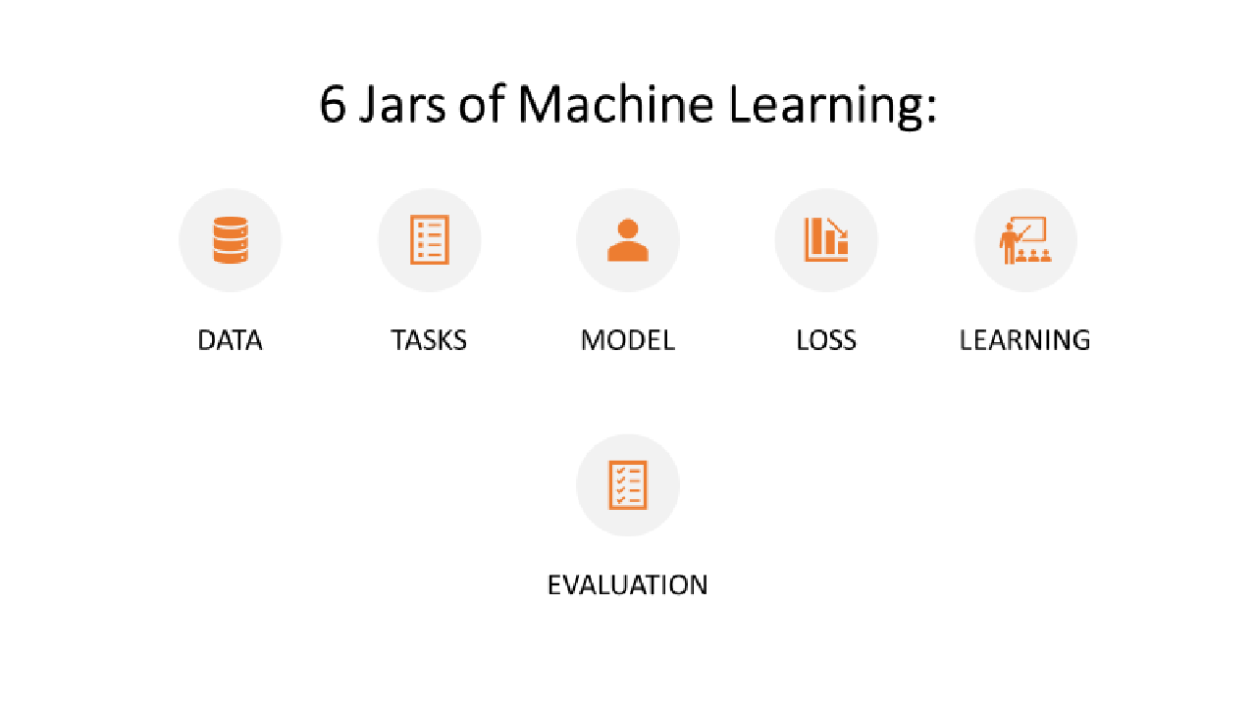

Slide 37
MACHINE LEARNING PROCESS
PROBLEM
STATEMENT
Imputing missing values.
Scaling and normalising features.
Feature engineering
Transforming categorical features into numeric
Supervised models.
Unsupervised models.
Reinforcement models.
Confusion matrix.
Accuracy
Precision & Recall
Train Test validation
Checking overfitting and underfitting
PREPROCESSING
MODELING
MODEL EVALUATION
DATA
Divide data into training and testing
Apply model as per problem statement.
Evaluate model performance

Slide 38

Scikit-Learn Design
The main design principles are :
Consistency - Estimators (fit()),Transformers (fit_transform()) and Predictors (predict() and score()) methods.
Inspection - Estimators hyper-parameters.
Nonproliferation of classes – Datasets are represented as Numpy arrays,instead of homemade classes.
Composition - To create a Pipeline Estimator.
Sensible defaults - Reasonable default values for most parameters

Slide 39
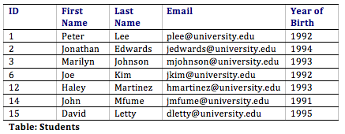
Attributes can also be termed as Feature, Variable, Dimension or Fields

Slide 40

Dataset: Collection of data
Model: Representation of what a ML System has learned from training data
Training : Process of determining the ideal parameters
Learning : Output of the training process,which a Machine Learning model can use to make predictions
Training dataset: subset of the data set to train a model
Validation dataset: Also a subset of dataset,disjunct from training dataset,that we use to adjust hyperparameters
Testing dataset:Used to test model which has gone through initial vetting by validation set.
Hyperparameter:Values which are set before training a model
Parameter:A variable of a model that ML System trains on its own.
Target: Output of the input variable also called as Dependent variable or Response variable.
Key points
Notes:
Talk about ML Cycle,Planning , Data Preparation,Modelling , Model Presentation.

Slide 41
Feature : Individual Independent variables that act as input in your system.These are also called as Independent variables or Predictor variables.
Label : Labels are the final output,such as output classes.
Fit : Capture patterns from provided data.Heart of Modelling.
Evaluate : Determine how accurate the model’s predictions are.
Regularization : Method to estimate a preferred complexity of Machine Learning so that the model generalizes,by avoiding underfitting and overfitting.
Key points

Slide 42
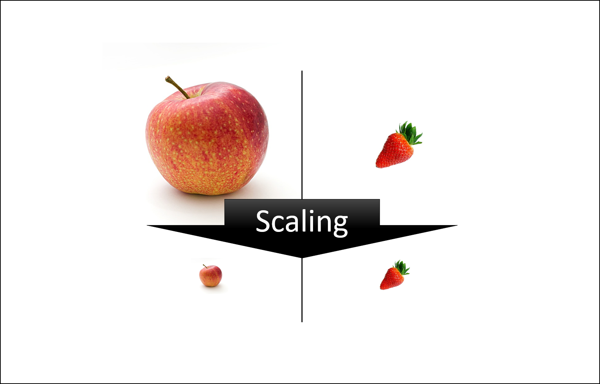
Feature Scaling
Feature scaling in machine learning is one of the most critical steps during the pre-processing of data before creating a machine learning model.
Scaling can make a difference between a weak machine learning model and a better one.
The most common techniques of feature scaling are Normalization and Standardization.

Slide 43
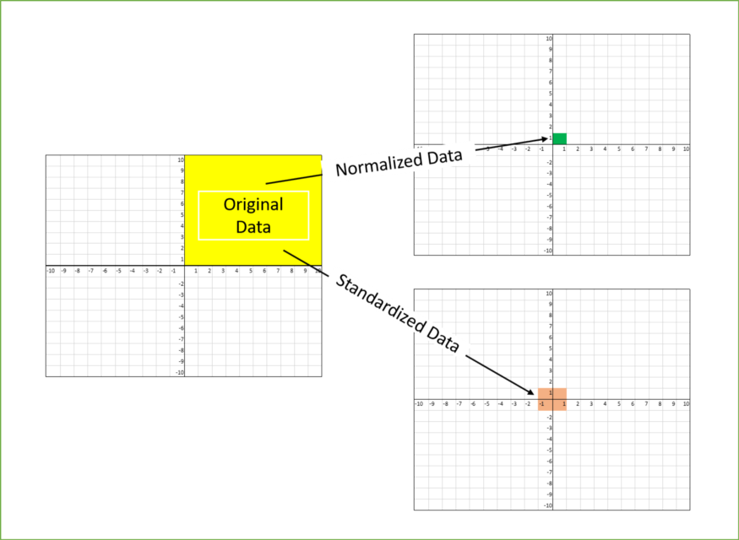
Normalization is used when we want to bound our values between two numbers, typically, between [0,1] or [-1,1].
While Standardization transforms the data to have zero mean and a variance of 1, they make our data unitless.

Slide 44

FEATURE SCALING
That’s why we scale the numeric features.
PRODUCT ID | PRICE IN INDIA(inr) | PRICE IN USA ($)
Features
ID-1 | 5000 | 80
ID-2 | 7000 | 50
ID-3 | 12000 | 140
ID-4 | 3000 | 25
5000 | 80
5000
>
80
Here can we say that the price in India is higher than the price in USA?
5000 INR
<
80 $
1 $
=
80 INR
We can only feed numbers in our machine learning algorithms.
80 80
=
6400 INR
UNIT
MAGNITUDE

Slide 45
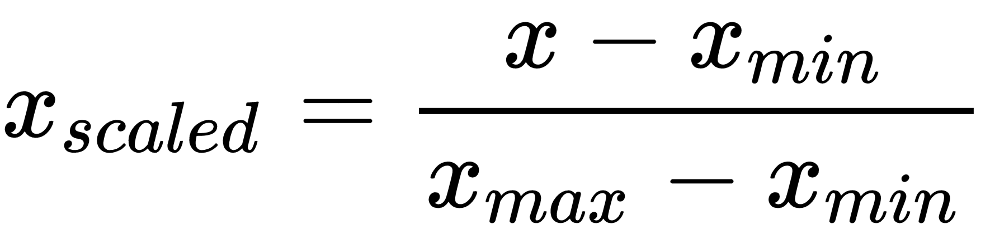
FEATURE SCALING
PRODUCT ID | PRICE IN INDIA(inr) | PRICE IN USA ($)
Min - Max Normalization
ID-1 | 5000 | 80
ID-2 | 7000 | 50
ID-3 | 12000 | 140
ID-4 | 3000 | 25
X
Feature scaling is a technique to standardize the independent features present in the data in fixed range.
5000 - 3000
12000 - 3000
= 0.22

Slide 46
FEATURE SCALING
PRODUCT ID | PRICE IN INDIA(inr) | PRICE IN USA ($)
Min - Max Normalization
ID-1 | 5000 | 80
ID-2 | 7000 | 50
ID-3 | 12000 | 140
ID-4 | 3000 | 25
X
Feature scaling is a technique to standardize the independent features present in the data in fixed range.
80 - 25
140 - 25
= 0.47

Slide 47
FEATURE SCALING
PRODUCT ID | PRICE
ID-1 | 50
ID-2 | 7000
ID-3 | 12000
ID-4 | 30
USD
INR

Slide 48
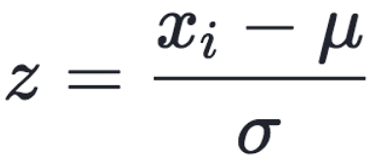
FEATURE SCALING
PRODUCT ID | PRICE IN INDIA(inr) | PRICE IN USA ($)
Standardization
ID-1 | 5000 | 80
ID-2 | 7000 | 50
ID-3 | 12000 | 140
ID-4 | 3000 | 25
Xi
Mean
Standard Deviation
5000 - 6750
3862.21
= - 0.45
Feature scaling is a technique to standardize the independent features present in the data in fixed range.
80 - 73.75
49.56
= - 0.12

Slide 49
FEATURE SCALING
PRODUCT ID | PRICE
ID-1 | 50
ID-2 | 7000
ID-3 | 12000
ID-4 | 30
USD
INR

Slide 50
Understanding the Big Picture
Navigate - Navigating the Landscape
Build - Working on Building Blocks and Utilizing the Resources
Launch – Networking and Building Portfolio
Maintain – Making career Future-Proof
Notes:
Learning is 20% Information and 80% Action
Job →Interview →Network →Portfolio →Core Skills →Resources →Awareness

Slide 51
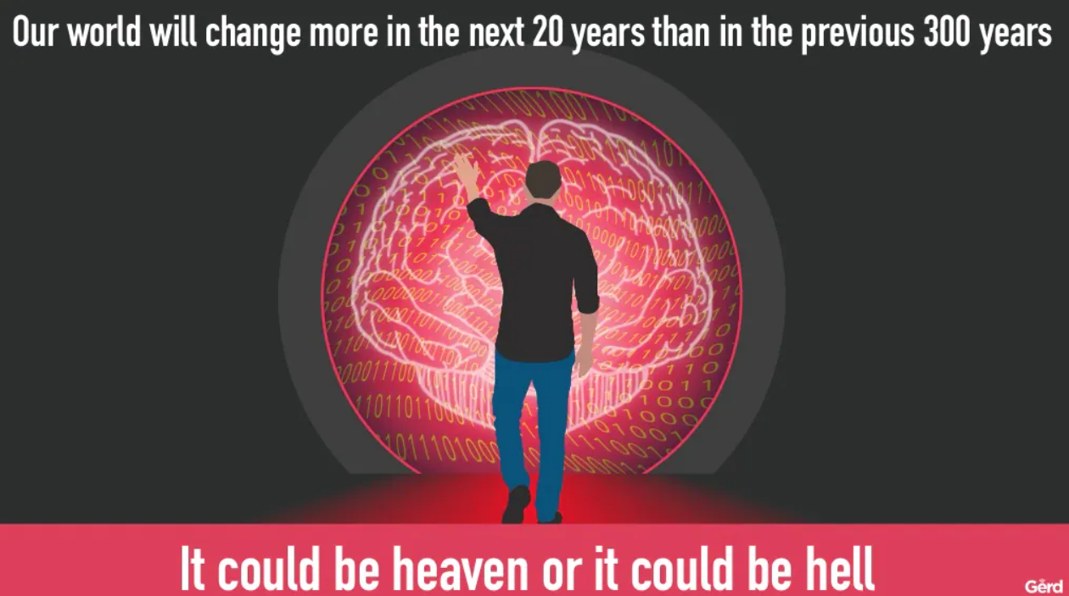

Slide 52
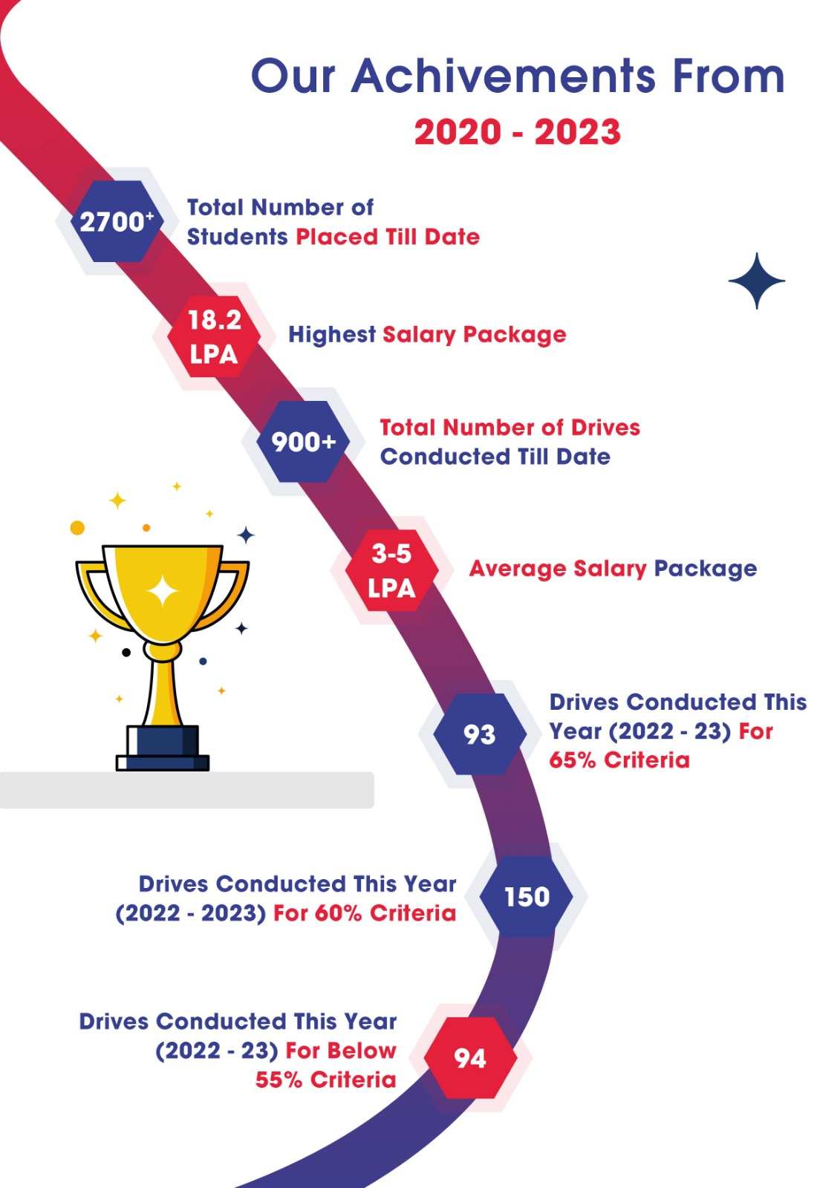

Slide 53




Our Achievements
Students Placed
Drives Conducted
2700
900
(Since from 24th
(Since from 24th
December 2020 till
date)
December 2020 till
date)
Our trainings have reached and also been validated by
multiple MNC’s in Singapore.

Slide 54

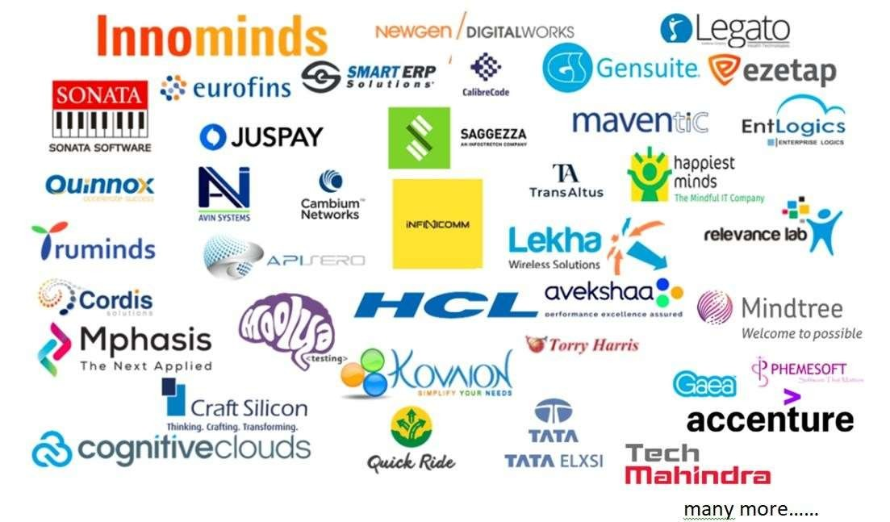
Our Top Recruiters

Slide 55


Slide 56


